Slide 1
Solution for effective utilization of coir raw material to avoid wastage
PIP2001 Capstone Project
Final Review
Batch Number: CST-G18
Under the Supervision of,
Mrs. Shaik Salma Begum
Professor
Presidency School of Computer Science and Engineering
Presidency University
Roll Number | Student Name
20211CST0006 | Nagaruru Sunandhan
20211CST0039 | Bobbiti Yaswanth Reddy
20211CST0041 | Kruthika S
Name of the Program: Btech
Name of the HoD: Dr. Saira Banu Atham
Name of the Reviewer: Dr. Saira Banu Atham
Name of the Program Project Coordinator: Dr. H M Manjula
Name of the School Project Coordinators: Dr. Abdul Khadar A

Slide 2
Introduction
Coir raw material often goes to waste due to insufficient real-time data on its availability and demand within the market.
This project aims to develop a platform where farmers and industries can efficiently track, manage, and utilize coir resources, addressing the issue of wastage.
The platform offers real-time information on coir raw material availability, enabling industries to plan and source resources effectively.
The system involves farmers, industries, and data analytical firms, all of whom register with valid credentials, ensuring transparency and trust.
By improving the management and utilization of coir, the platform aims to reduce wastage and significantly increase profitability for all stakeholders involved.

Slide 3
Literature Review
Utilization of waste coir fibre architecture to synthesize porous graphene oxide and their derivatives [Krishna K. Yadav ,Harish Singh, Supriya Rana (2020)].
Uptake of dyes by a promising locally available agricultural solid waste [Namasivayam, R. Radhika (2000)].
Utilization of coconut waste for production of activated carbon and its application as a low-cost adsorbent in environment treatment [Hoang,Thi Cam Quyen Ngo (2023)].
A state-of-the-art review on coir fiber-reinforced biocomposites [Hasan, Miklos Bak, Tibor Alpar​ (2021)].
Effective utilization of natural fibres (coir and jute) for sustainable low-volume rural road construction [Nitish Kumar, Ramesh K. Kandasami (2022)].
Coir Geotextile-Packed Conduits for Wastewater Treatment [A. Praveen, P. B. Sreelakshmy 2008].

Slide 4
Literature Review
Physical and Chemical Properties of Coir Waste and Plant Growth[P.Noguera, M.Abad (1997)].
Coir from Coconut Processing Waste: Applications Beyond Traditional Uses. [Wolfgang Stelte, Narendra Reddy(2022)]
Coconut coir waste, a new and viable ecologically- Friendly peat substitute [Patricia Noguera,M. Abad(2000)]
Coir Waste Management for Hydroponics in Berries [Dr Doris Blaesing, RM Consulting Group(2011)]

Slide 5
Research Gaps Identified
Sl No | Study | Gap
1 | Optimization of Fiber Extraction Processes | Incomplete Extraction and Inconsistent Quality
2 | Improvement in Coir Waste Management | Limited Waste Recycling and Repurposing
3 | Utilization of Coir Waste in High-Value Products | Limited Application in High-Value Industries
4 | Sustainability and Circular Economy Integration | Lack of Comprehensive CircularEconomy Models
5 | Energy Efficiency in Coir Processing | High Energy Consumption in Processing
6 | Development of Coir-Based Composites and Advanced Materials | Underutilization in Advanced Material Sectors
7 | Coir Waste as a Sustainable Soil Amendment | Limited Research on Long-Term Soil Benefits
8 | Data-Driven Approaches for Coir Waste Optimization | Lack of Real-Time Data on Coir Waste Generation and Utilization
9 | Market Development for Coir Waste Byproducts | Lack of Established Markets for Coir Waste Byproducts
10 | Coir Waste and Environmental Impact Assessment | Insufficient Environmental Impact Assessments

Slide 6
Proposed Methodology
The proposed solution involves creating a centralized web platform where various stakeholders—such as farmers, industries, and data analytics firms—can track, update, and manage coir raw materials. This includes :
Registration & Authentication: Secure system for transparent user registration.
Data Collection: Farmers provide real-time updates on coir availability via web or SMS.
Material Search: Industries access real-time availability data and place orders.
Transaction Recording: Automatic logging of transaction details in a database.
Data Management: Centralized database for storing user, availability, and transaction data.
Analytics: Firms access transaction data for analysis and trend forecasting.
Communication: SMS and web-based notifications for seamless communication.

Slide 7
Objectives
To manage and track coir raw materials.
To reduce coir raw material wastage.
To improve resource allocation.
To streamline transactions.
To Ensure transparency.
To include farmers in remote areas.
To support decision-making.

Slide 8
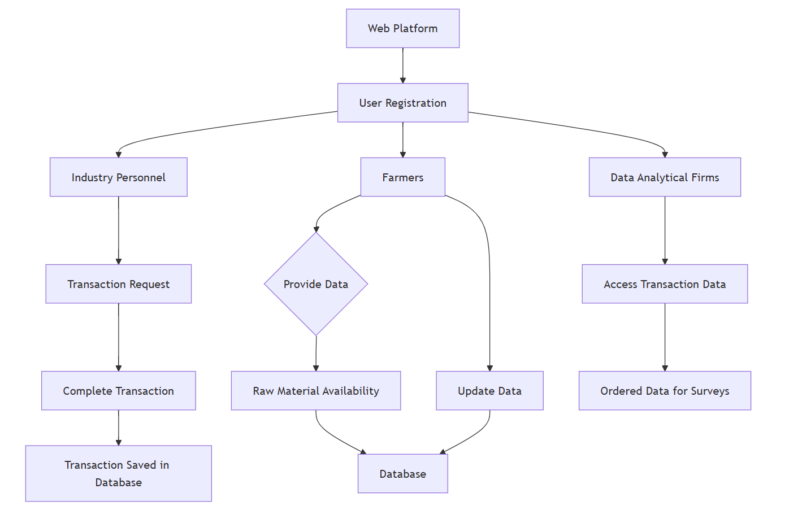
System Design & Implementation

Slide 9
System Design & Implementation
The platform leverages a comprehensive technology stack for efficient, secure, and scalable functionality. Frontend development utilizes HTML, CSS, JavaScript, and Bootstrap, ensuring a responsive, interactive, and accessible user interface. Django powers the backend, handling complex server-side operations, API integrations, and secure authentication, with database support for SQLite, PostgreSQL, and optional MongoDB for structured and unstructured data management. Key features include role-specific dashboards for farmers, industries, and analysts, AI-powered chatbots for query resolution, and robust transaction management with dynamic updates. Security measures like data encryption, Django’s authentication system, and role-based access control safeguard user data. The development process involves planning, design, implementation, testing, deployment, and continuous maintenance. Future enhancements include AI-driven supply-demand predictions, dedicated mobile apps for Android and iOS, and blockchain integration for enhanced transaction transparency and accountability, ensuring the platform remains innovative and user-centric.

Slide 10
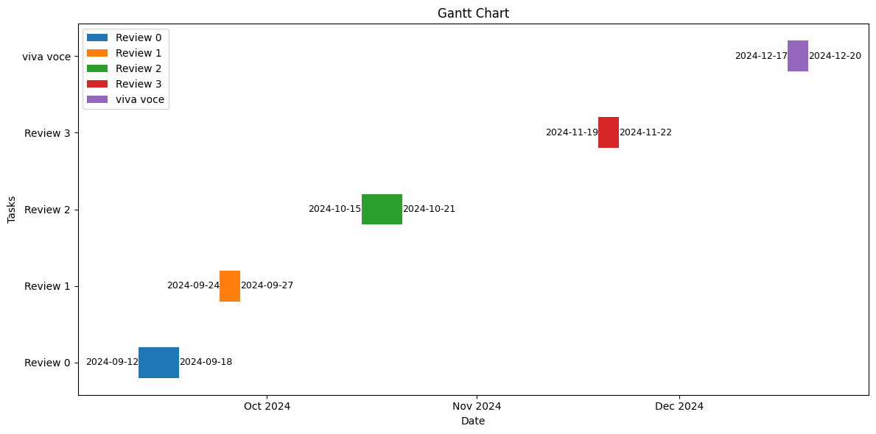
Timeline of Project

Slide 11
Outcomes
Efficient Coir Utilization: Minimized wastage of coir raw material through real-time tracking.
Increased Farmer Revenue: Farmers can directly sell to industries, maximizing their earnings.
Expanded Market Reach: Farmers can access buyers beyond their local region.
Transparency in Transactions: Valid ID verification ensures transparency in all deals.
Reduced Middlemen Dependency: Direct farmer-to-industry sales eliminate unnecessary intermediaries.
Time and Cost Savings: Farmers and industries save time by using the platform for transactions.
Improved Decision-Making: Data analytics firms get organized transaction data for insights.

Slide 12
Conclusion
The proposed website facilitates efficient coir raw material utilization by connecting farmers, industry personnel, and data firms. It provides real-time updates on material availability, manages transactions, and ensures transparency through a centralized database. With both web and SMS access, farmers can easily update stock, while industry owners can source materials efficiently. The platform reduces wastage, supports data-driven insights, and optimizes resource use in the coir industry.

Slide 13
References
Coconut coir waste, a new and viable ecologically- Friendly peat substitute https://www.researchgate.net/publication/286988277_Coconut_coir_waste_a_new_and_viable_ecologically-_Friendly_peat_substitute
Coir geotextile-packed conduits for the removal of biodegradable matter from wastewater https://www.jstor.org/stable/24102806
Coir from Coconut Processing Waste as a Raw Material for Applications beyond Traditional Uses https://www.researchgate.net/publication/365419789_Coir_from_coconut_processing_waste_as_a_raw_material_for_applications_beyond_traditional_uses
Effective utilization of natural fibres (coir and jute) for sustainable low-volume rural road construction https://www.sciencedirect.com/science/article/abs/pii/S0950061822022632
Coir from Coconut Processing Waste as a Raw Material for Applications beyond Traditional Uses https://researchprofiles.ku.dk/en/publications/coir-from-coconut-processing-waste-as-a-raw-material-for-applicat

Slide 14
References
A state-of-the-art review on coir fiber-reinforced biocomposites https://pubs.rsc.org/en/content/articlelanding/2021/ra/d1ra00231g
Utilization of coconut waste for production of activated carbon and its application as a low-cost adsorbent in environment treatment https://pubs.aip.org/aip/acp/article-abstract/2943/1/030006/2931471/Utilization-of-coconut-waste-for-production-of?redirectedFrom=fulltext
Uptake of dyes by a promising locally available agricultural solid waste https://www.sciencedirect.com/science/article/abs/pii/S0956053X00000817
Utilization of waste coir fibre architecture to synthesize porous graphene oxide and their derivatives https://www.sciencedirect.com/science/article/abs/pii/S0959652620342852
PHYSICAL AND CHEMICAL PROPERTIES OF COIR WASTE AND THEIR RELATION TO PLANT GROWTH https://www.actahort.org/books/450/450_45.htm
Coir geotextile-packed conduits for the removal of biodegradable matter from wastewater https://www.jstor.org/stable/24102806

Slide 15
Publication Details
Journal Name : Mukt Shabd
Status : published
Link : https://drive.google.com/file/d/1yTcTKjIdzqgMFky2zrwLArBC3cOiaOkw/view

Slide 16


